Slide 1
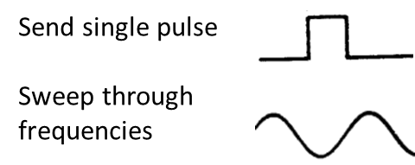
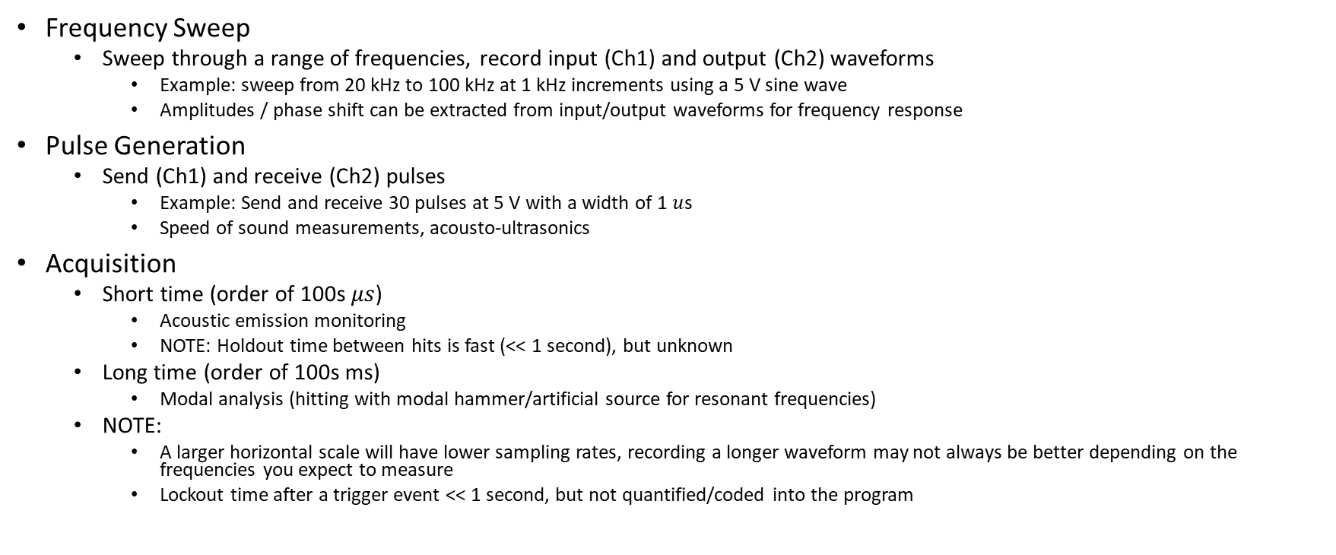
2-channel Oscilloscope + LabVIEW + Transducers can be used for multiple acoustic non-destructive evaluation techniques
Frequency Sweep
Sweep through a range of frequencies, record input (Ch1) and output (Ch2) waveforms
Example: sweep from 20 kHz to 100 kHz at 1 kHz increments using a 5 V sine wave
Amplitudes / phase shift can be extracted from input/output waveforms for frequency response
Pulse Generation
Send (Ch1) and receive (Ch2) pulses
Example: Send and receive 30 pulses at 5 V with a width of 1 $u$s
Speed of sound measurements, acousto-ultrasonics
Acquisition
Short time (order of 100s $μs$)
Acoustic emission monitoring
NOTE: Holdout time between hits is fast (<< 1 second), but unknown
Long time (order of 100s ms)
Modal analysis (hitting with modal hammer/artificial source for resonant frequencies)
NOTE:
A larger horizontal scale will have lower sampling rates, recording a longer waveform may not always be better depending on the frequencies you expect to measure
Lockout time after a trigger event << 1 second, but not quantified/coded into the program

Slide 2
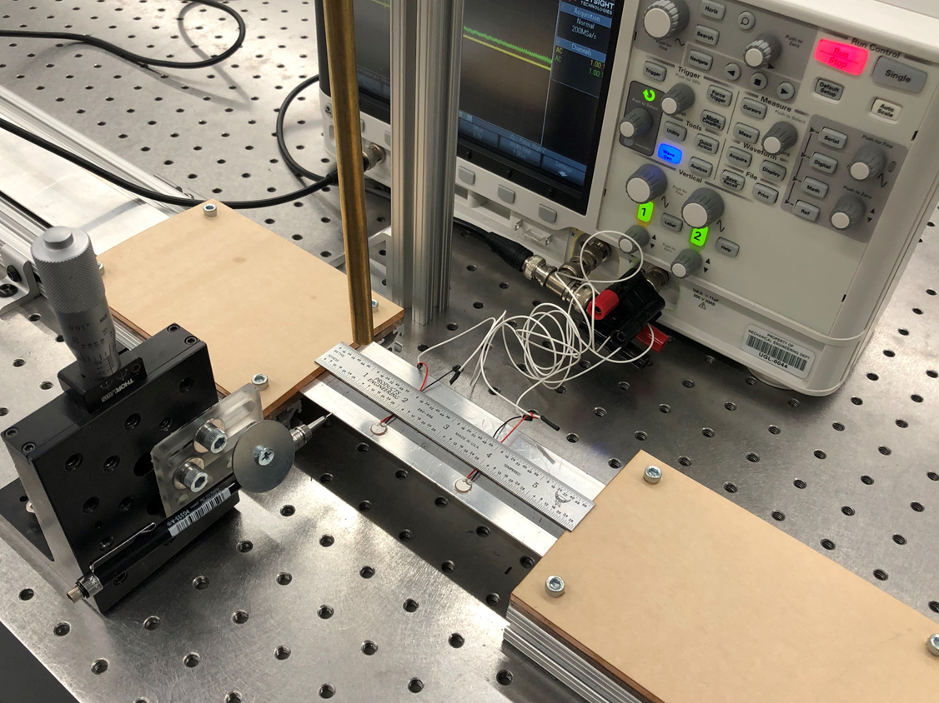
Piezos hooked up to WaveGen, Ch1, and Ch2 of Keysight InfiniiVision 2000X
Back of oscilloscope has Device port which is connected to PC via USB
PC
Oscilloscope
WAVE GEN
Ch1
Ch2
BNC Cable
3 way BNC
Piezo 1
Piezo 2

Slide 3
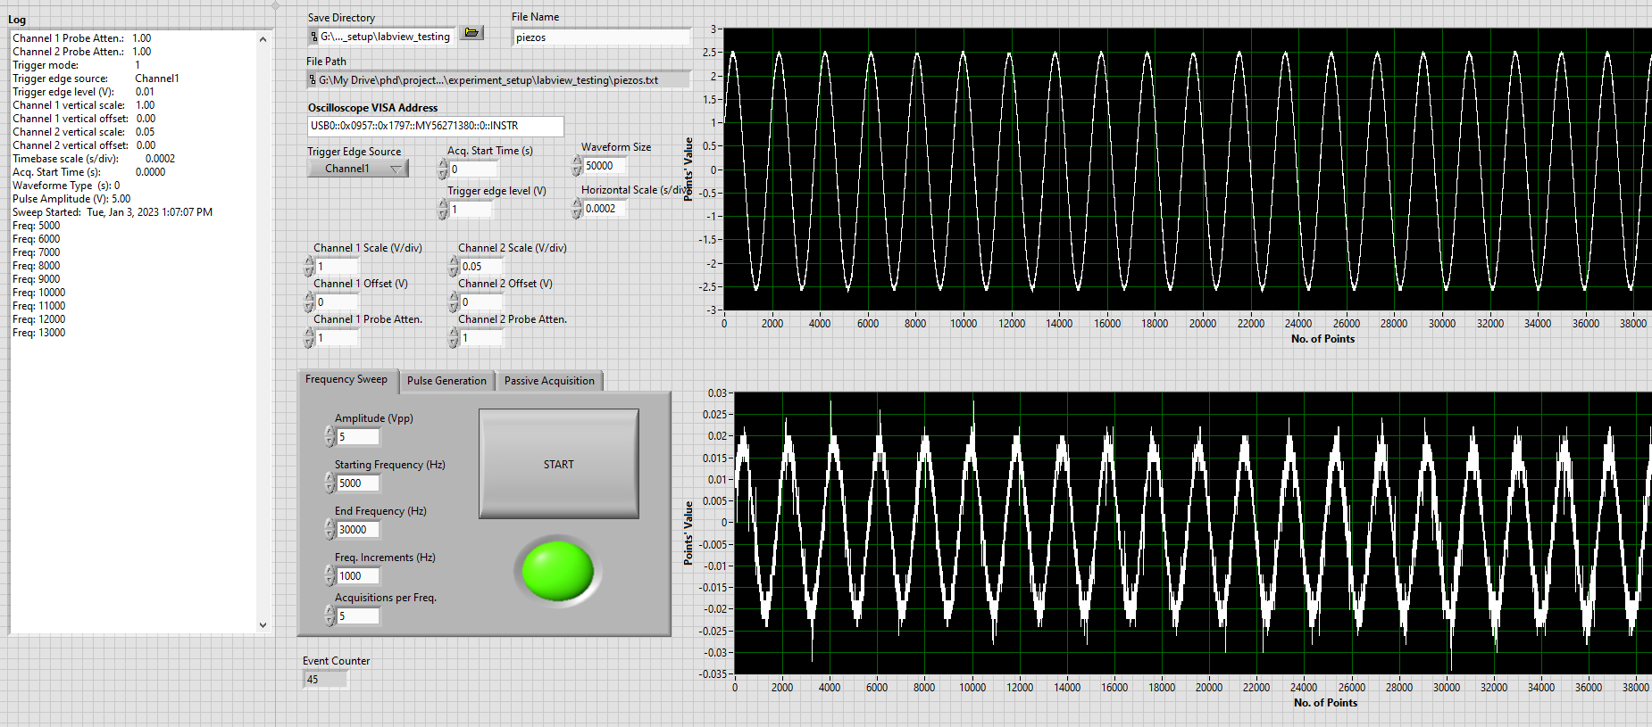
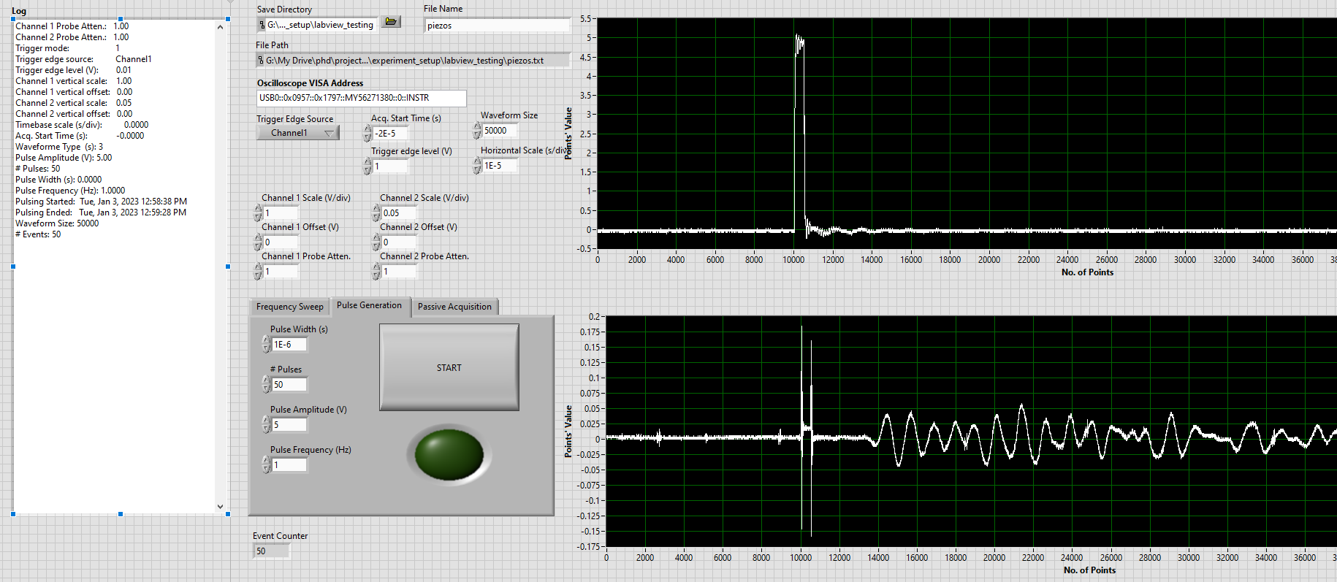
FREQUENCY SWEEP
PULSE GENERATION
CH1 INPUT SIGNAL
CH1 INPUT SIGNAL
CH2 RECEIVED SIGNAL
CH2 RECEIVED SIGNAL

Slide 4
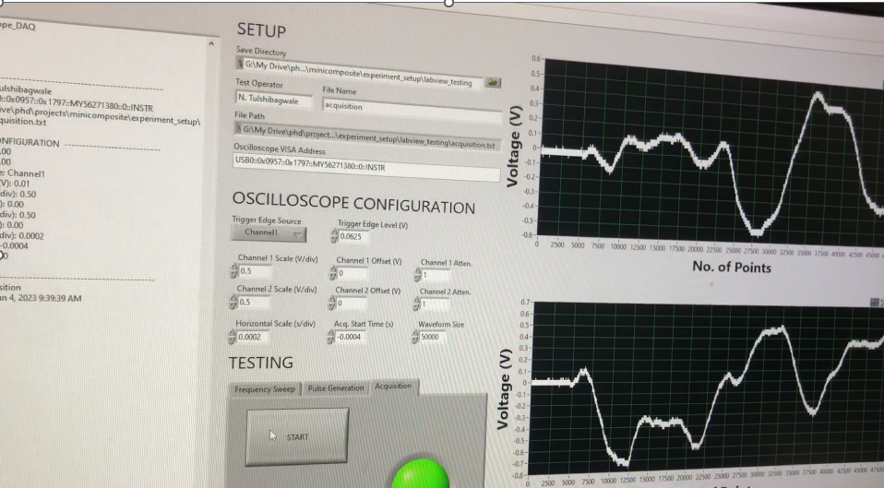
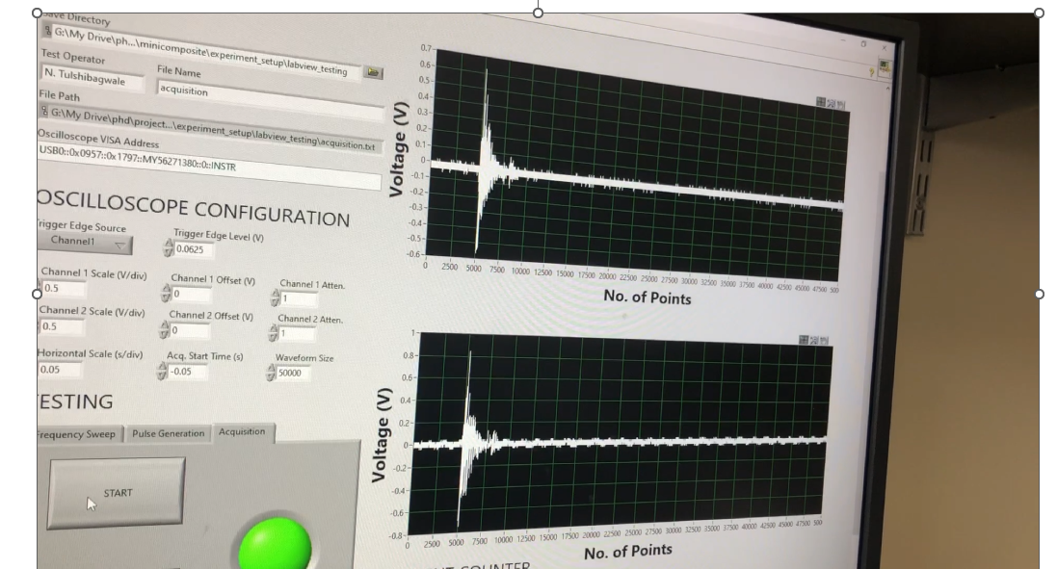
ACOUSTIC EMISSION
MODAL ANALYSIS

Slide 5
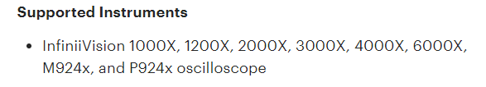
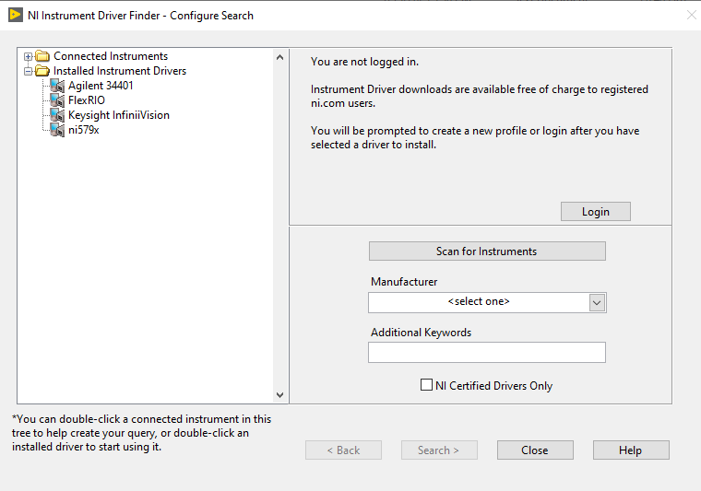
Equipment, software, drivers
Keysight InfiniiVision Oscilloscope
Programmed using 2000X model
Program should work for other InfiniiVision models (3000X, 4000X, etc.) but I have not verified this
Useful links for learning more
https://www.youtube.com/watch?v=YkmUGGwUhYo
https://www.youtube.com/watch?v=Q4PpfmaSf5I
https://knowledge.ni.com/KnowledgeArticleDetails?id=kA03q000000x3XpCAI&l=en-US
Software needed:
LabVIEW 2017, base development
IO Libraries Suite
https://www.keysight.com/us/en/lib/software-detail/computer-software/io-libraries-suite-downloads-2175637.html
This should allow you to connect oscilloscope to PC via Device port and IO Libraries Suite, VISA address is acquired from this panel
Drivers specific to Keysight Oscilloscopes that let you program easily in LabVIEW
Driver 1
https://www.keysight.com/us/en/lib/software-detail/driver/infiniivision-xseries-oscilloscope-ivi-and-matlab-instrument-drivers-2019021.html
Driver 2
https://www.keysight.com/us/en/lib/software-detail/driver/infiniivision-xseries-oscilloscope-labview-instrument-drivers-2862255.html
Any transducers should work
https://www.steminc.com/PZT/en/piezo-disc
From driver page:

Slide 6
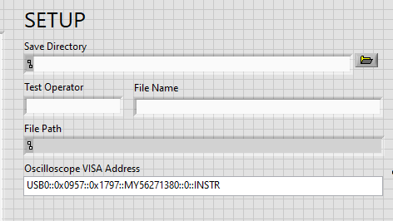
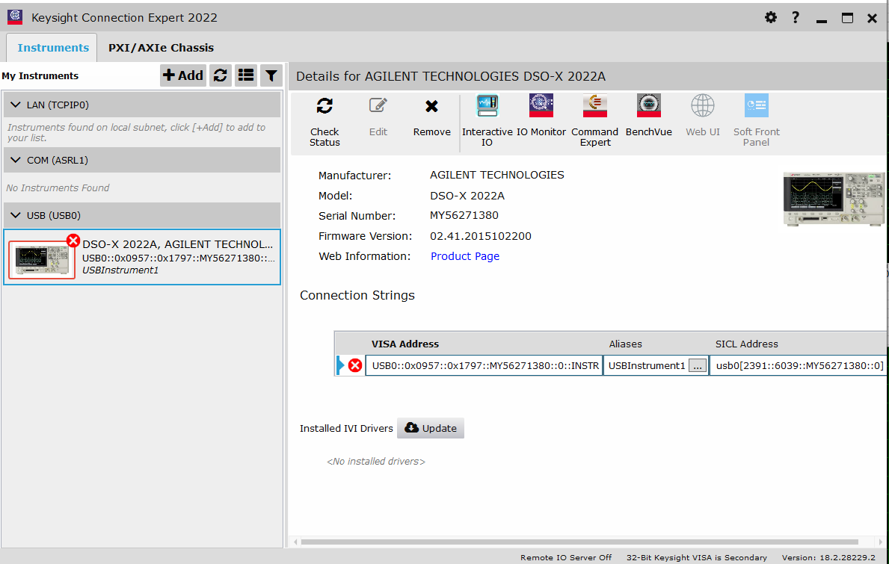
Procedure:
1. With LabVIEW and drivers properly installed, open program
2. Enter information into SETUP
Important that file name is changed after every test, otherwise will OVERWITE previously saved .txt files in the working directory with same name
Oscilloscope VISA Address must be changed to your oscilloscope from Keysight IO Suite / Connection Expert
(will be green checkmark when plugged in)

Slide 7
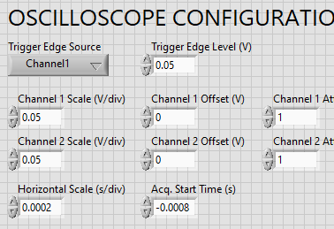
Procedure:
3. Enter information into OSCILLOSCOPE CONFIGURATION
Trigger edge source: which channel waveform triggers an event
Trigger edge level: voltage threshold which triggers an acquisition for trigger edge source
Channel 1 / 2 Scale: depends on the amplitude of the waveform you expect to measure
Offset and attenuation generally don’t need to be changed
Horizontal scale: this determines the length of signal you will acquire
Acquisition start time: this determines pretrigger length (make sure to put a negative sign)

Slide 8
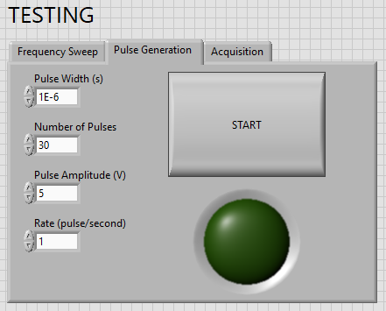
Procedure:
4. If running Frequency Sweep or Pulse Generation test, enter parameters
Frequency Sweep:
Amplitude: amplitude of the Ch1 waveform, max is 5 V
Initial Frequency: Initial sine wave frequency
Stop Frequency: final sine wave frequency
Freq. Increments: Increment size from initial frequency until stop frequency
Acq. Per Freq: How many waveforms acquired per frequency
Delay: time between each acquisition (too fast will crash oscilloscope, about 1 second appears okay)
Pulse Generation:
Pulse width: width of square pulse
Rate: again, too fast may crash oscilloscope

Slide 9
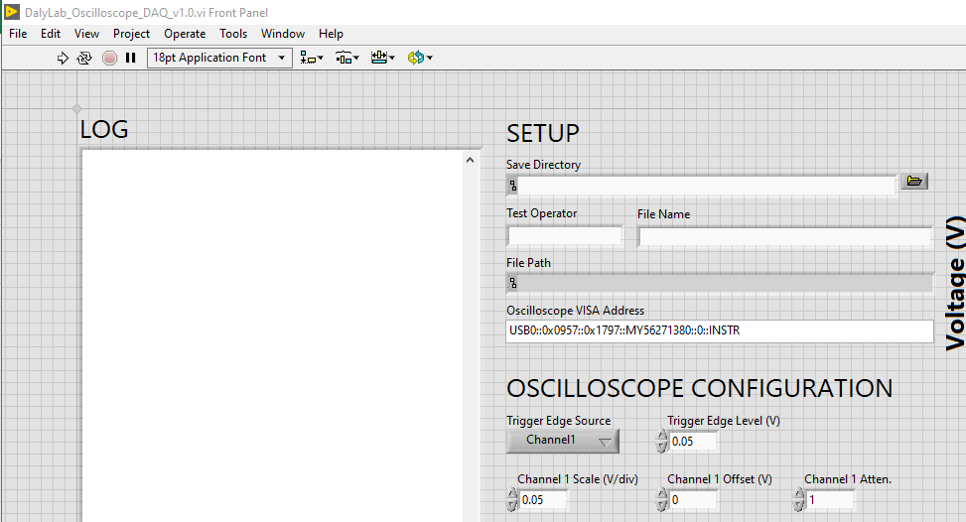
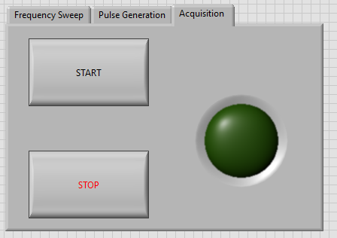
Procedure:
5. Once all parameters are entered, hit run program
Oscilloscope will REBOOT (you will probably hear a clicking sound), and configure itself to the entered parameters in OSCILILOSCOPE CONFIGURATION, but will not start test
Will begin LOG with entering configuration information and time
When ready, hit START button for selected test
Frequency Sweep and Pulse Generation will run to completion, when program completed it will output .txt file of acquired waveforms
If running Acquisition, end the test by pressing STOP button (don’t press stop sign at the top of the program window, will not save)

Slide 10
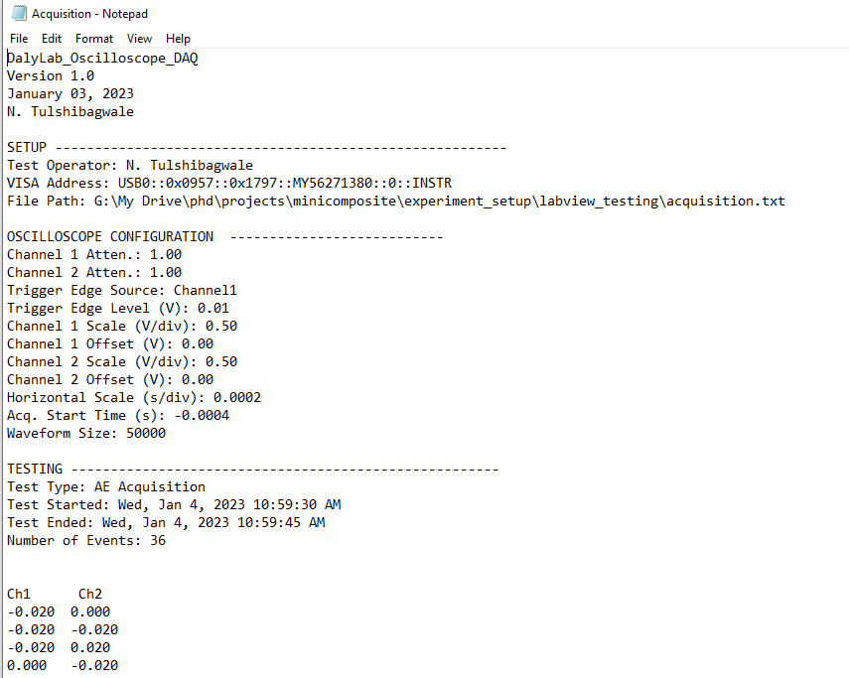
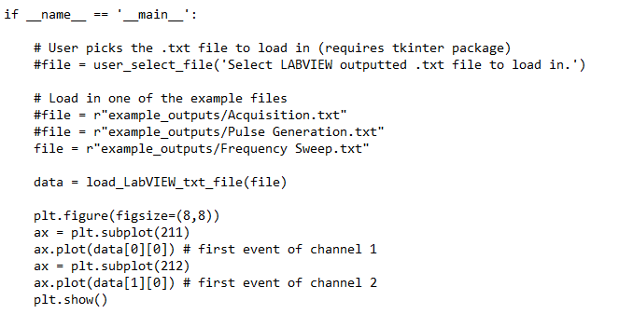
Procedure:
6. Text .txt file will be saved to directory with settings and data
7. Waveform data is saved Ch1 and Ch2, 50000 sample points per waveform
Total number of data points: 50,000 * number of events
8. Use python script, ‘load_example_outputs.py’ to load data
If run code directly (__main__ func), it will load in .txt files from example outputs for the 3 type of tests
Data points stored in two long columns

Slide 11
Troubleshooting / Advice
Find correct configuration for test and oscilloscope generally requires trial and error. But this can all be done MANUALLY using oscilloscope controls while operating in SINGLE mode and using the WaveGen.
If using an AMPLIFIER, be careful at start up: When the scope resets, it will default to a 1V sine wave which when amplified could be much larger in your circuit
CHANGE FILE NAME! Files will OVERWRITE if name is kept the same. DOES NOT APPEND!
Oscilloscope randomly crashes during pulse generation and frequency sweep; it is unclear why this occurs but probably due to rate at which events are occurring.
Pulse generation “rate” and frequency sweep “delay” can be increased
Recommendation is to go for shorter tests, and more data files; for instance, perform multiple frequency sweeps (100-200 kHz, 200-300 kHz, etc.) rather than 100-500 kHz.
AE monitoring for long term mechanical tests not recommended
Sampling rate depends on the length of acquisition
A larger horizontal scale will have lower sampling rates, so recording a longer waveform may not always be better depending on the frequencies you expect to measure, the sampling rate appears on the oscillscope
Lockout time after a trigger event << 1 second, but not quantified/coded into the program

Slide 12
Python File Addition – May 3, 2024 ‘store_infiniivision_oscilloscope_data_as_binary’
Modified ‘brute-force’ script from InfiniiVision page
IO Suite Libraries is needed on host computer.
PyVisa library needed in python
Additional Driver for VISA/USB? Might be okay with just IO Suite Libraries (Not sure yet)

